Slide 1
Experimental Methodology Proposal
April 27, 2019 Thoughts on experimental methodology

Slide 2
Paper Sections (make these the new Latex section names)
CL construction [[ emphasize incr. Algo ]]
Subsection: Jaccard Similarity
How to obtain Jaccard Similarity Matrix (JSM) from CL
Example [[ this may be well-known; write just enough ]]
Ranking Suspicious PTs [[ good to expand on ]]
diffNLR: Reflecting differences [[ important to expand on ]]
Experiments: Methodology and Results
[[ Saeed: write v1 by 5/9 say 8pm ]]
Detailed bullets for ILCS:
Start putting results tables you have now
High-quality tables / diagrams
Discussions
Related Work [[ good; write last ]]
Performance Analyzers:
TAU
Score-p
HPC Tracing
Scalatrace
Pivot Tracing
Debuggers
AutomaDeD
STAT
PRODOMETER
FCA
Vijay Garg’s on distributed applications
Dimitry Ignatov (FCA applications)
Concluding Remarks
Intro (Ganesh can write)
Importance of whole program diffing : understand changes, debug
Efficient tracing supports selective monitoring at multiple levels
Bugs not there at a predictable API level
Prior work (ParLoT) supports whole program tr.
Dissimilarity is important to know: bugs, changes during porting,...
Key enablers of meaningful diffing:
Formal concepts (novel contrib to debugging)
Loop detection (loop diffing can help)
Importance, given the growing heterogeneity
Background
[[Saeed: priority-1: write v1 quickly by 5/9 AM (bulleted writing is OK for v1) ]]
ParLOT (dynamic binary trace collection):
ParLOT overview (diagram) [[ diagram is overkill ]]
PT definition [[ mention in English; see if that works ]]
Loop Structure Detection [[ important section ]]
Background on loop detection, related work
Why we need it? intra-PT compression
Loop structures definition
Equivalencing behavior via FCA [[ important ]]
Why CLs? [[ important; Concept Lattices bg + our use ]]
Inter-PT compression
Extracting similarities
Integrating all traces into a single entity as the model of execution [[ good point ]]

Slide 3
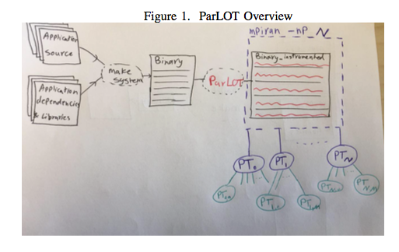

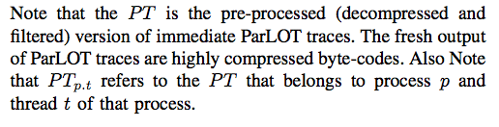
ParLOT Trace (PT) definition

Slide 4
DiffTrace Components
After collecting ParLOT traces (main image or all images), here is the pipeline of trace processing and analysis in DiffTrace:
Preprocessing (implemented in C++):
Decompression
Filter (slide Filters)
NLR: Detecting Loops (intra-PT compression)
Forming Equivalent Classes of PTs (inter-PT compression) (implemented in C++)
Attribute Extraction
Concept Lattice Generation
Jaccard Similarity Matrix (JSM) Calculation
Analysis of JSMs and rank abnormal PTs for deeper analysis (implemented Python, SciPy, NumPy)
Tunable analysis
Iterative rankings
diffNLR (visualization of diffs of buggy PT vs. its corresponding native PT)

Slide 5
DiffTrace Components
After collecting ParLOT traces (main image or all images), here is the pipeline of trace processing and analysis in DiffTrace:
Preprocessing (implemented in C++):
Decompression
Filter (slide Filters)
NLR: Detecting Loops (intra-PT compression)
Forming Equivalent Classes of PTs (inter-PT compression) (implemented in C++)
Attribute Extraction
Concept Lattice Generation
Jaccard Similarity Matrix (JSM) Calculation
Analysis of JSMs and rank abnormal PTs for deeper analysis (implemented Python, SciPy, NumPy)
Tunable analysis
Iterative rankings
diffNLR (visualization of diffs of buggy PT vs. its corresponding native PT)

Slide 6
Pre-processing of PTs
Decompression
Compressed PT
Decompressor (By Martin and Sindhu)
Sequence of Function IDs
PT INFO

Slide 7

Pre-processing of PTs
Decompression
Filters
Filters Regex
Filter
Sequence of Function IDs
Sequence of Function Names
PT INFO

Slide 8

Pre-processing of PTs
Decompression
Filters
NLR (intra-PT compression)
Sequence of Function Names
Compressed Human-Readable Nested Loop Representation (NLR) of each PT
NLR (Nested Loop Recognition)

Slide 9
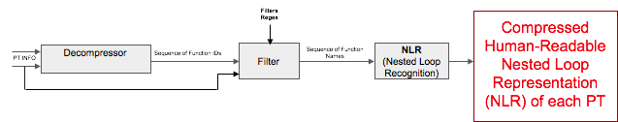
Pre-processing of PTs
Decompression
Filters
NLR (intra-PT compression)
NLR-PTs for each set of filters is written to disk
Each NLR-PT is holding information about the sequence of function calls and returns based on the applied filter and its loop structures.
Various types of Attributes would be extracted from each NLR-PT for inter-PT compression and analysis

Slide 10
DiffTrace Components
After collecting ParLOT traces (main image or all images), here is the pipeline of trace processing and analysis in DiffTrace:
Preprocessing (implemented in C++):
Decompression
Filter (slide ??)
NLR: Detecting Loops (intra-PT compression)
Forming Equivalent Classes of PTs (inter-PT compression) (implemented in C++)
Attribute Extraction
Concept Lattice Generation
Jaccard Similarity Matrix (JSM) Calculation
Analysis of JSMs and rank abnormal PTs for deeper analysis (implemented Python, SciPy, NumPy)
Tunable analysis
Iterative rankings
diffNLR (visualization of diffs of buggy PT vs. its corresponding native PT)

Slide 11
What is the goal now?
- HPC applications would result in thousands of independent traces (PTs).
- Analysis of large number of PTs is not feasible.
- A mechanism is needed to reduce the search space (inter-PT compression) from thousands of PTs to just a few equivalent classes of PTs.
- Due to typical HPC application common topologies such as SPMD, master/worker and odd/even where multiple processes/threads behave similarly, our experiments show that large number of PTs can be reduced to just a few groups.

Slide 12
Next Slides
Background about Jaccard Similarity Score
Example to show how to compute Jaccard Similarity Score manually
Example to show how to compute Jaccard Similarity Score via Concept Lattice

Slide 13
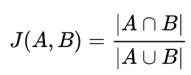
Jaccard Similarity Score
Question: How to classify/cluster PTs?
Answer: Calculating their Jaccard Similarity Score
From wikipedia:
The Jaccard similarity index (sometimes called the Jaccard similarity coefficient) compares members for two sets to see which members are shared and which are distinct. It’s a measure of similarity for the two sets of data, with a range from 0% to 100%. The higher the percentage, the more similar the two populations.
Each PT is a set of function calls and returns. Thus Jaccard index can gives us an estimation of how similar two PTs are

Slide 14
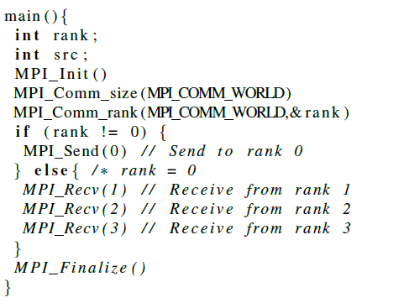
Example

Slide 15
Example
Running the sample code with 4 processes and collecting ParLOT traces would result in
PT₀
PT₁
PT₂
PT₃

Slide 16
Example
Each column is a set of functions belong to each PT (regardless of their frequency)
PT₀ | PT₁ | PT₂ | PT₃
MPI_Comm_size() | MPI_Comm_size() | MPI_Comm_size() | MPI_Comm_size()
MPI_Comm_rank() | MPI_Comm_rank() | MPI_Comm_rank() | MPI_Comm_rank()
MPI_Recv() | MPI_Send() | MPI_Send() | MPI_Send()
MPI_Finalize() | MPI_Finalize() | MPI_Finalize() | MPI_Finalize()

Slide 17
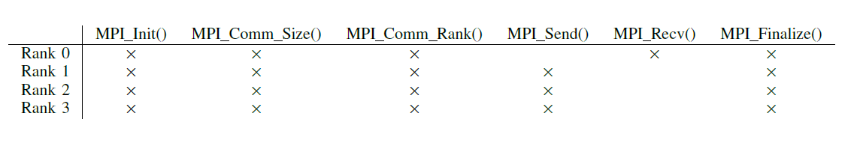
Measuring Similarities
Now from the above context, we can calculate pair-wise Jaccard similarity for each pair of PTs. For example:
Jaccard (PT₀, PT₁) = ?

Slide 18
Measuring Similarities
Now from the above context, we can calculate pair-wise Jaccard similarity of each pair of PTs. For example:
Jaccard (PT₀, PT₁) = ?
| PT₀ ∩ PT₁| = 4

Slide 19
Measuring Similarities
Now from the above context, we can calculate pair-wise Jaccard similarity of each pair of PTs. For example:
Jaccard (PT₀, PT₁) = ?
| PT₀ ∩ PT₁| = 4
| PT₀ ∪ PT₁| = 6

Slide 20
Measuring Similarities
Now from the above context, we can calculate pair-wise Jaccard similarity of each pair of PTs. For example:
Jaccard (PT₀, PT₁) = ?
| PT₀ ∩ PT₁| = 4
| PT₀ ∪ PT₁| = 6
Jaccard (PT₀, PT₁) = 4 / 6 = 0.67

Slide 21
Measuring Similarities
Now from the above context, we can calculate pair-wise Jaccard similarity of each pair of PTs. For example:
Jaccard (PT₀, PT₁) = ?
| PT₀ ∩ PT₁| = 4
| PT₀ ∪ PT₁| = 6
Jaccard (PT₀, PT₁) = 4 / 6 = 0.67
Similarly, Jaccard (PT₁, PT₂) = 1 (i.e., Identical)

Slide 22
Remember our Goal? Classifying PTs
Calculating pair-wise Jaccard score of all pairs of PTs in an HPC application is infeasible (too much computation).

Slide 23
Remember our Goal? Classifying PTs
Calculating pair-wise Jaccard score of all pairs of PTs in an HPC application is infeasible (too much computation).
Solution:
Obtain Jaccard Similarity Scores via Formal Concept Analysis (FCA).

Slide 24
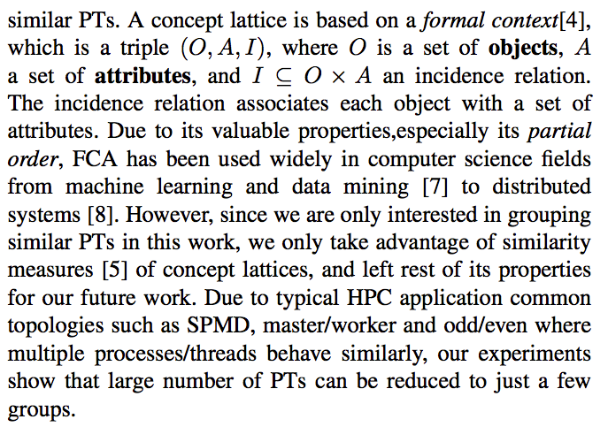
Remember our Goal? Classifying PTs
Calculating pair-wise Jaccard score of all pairs of PTs in an HPC application is infeasible (too much computation).
Solution:
Obtain Jaccard Similarity Scores via Formal Concept Analysis (FCA).

Slide 25
Back to Example

Slide 26
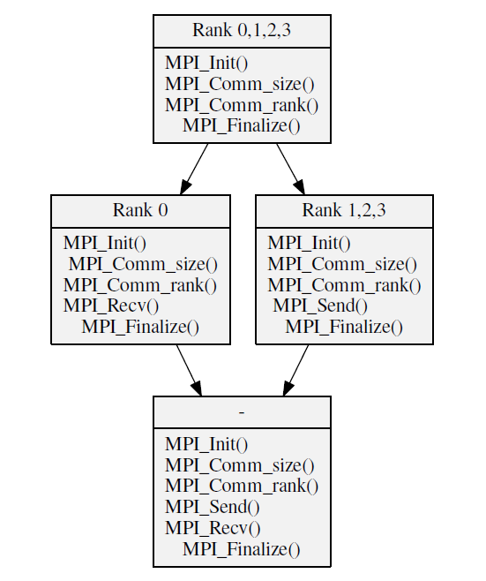
Concept Lattice

Slide 27
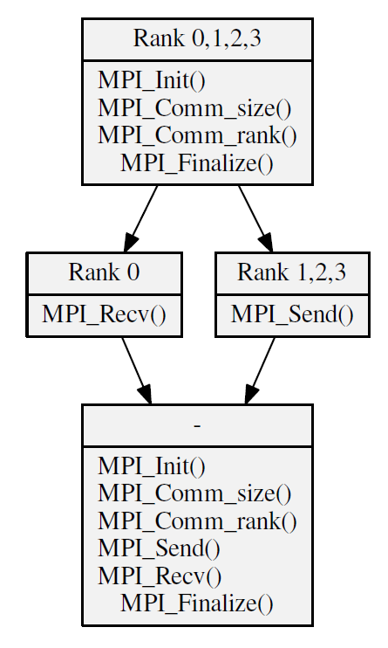
Concept Lattice
(Reduced)

Slide 28

Concept Lattice vs Jaccard

Slide 29
Concept Lattice vs Jaccard
Definition: LCA (A,B) in tree T is the Lowest Common Ancestor of A and B in the tree T
Jaccard Similarity (Rank 0, Rank 1) = ?
| Rank 0 ∩ Rank 1| =

Slide 30
Concept Lattice vs Jaccard
Definition: LCA (A,B) in tree T is the Lowest Common Ancestor of A and B in the tree T
Jaccard Similarity (Rank 0, Rank 1) = ?
| Rank 0 ∩ Rank 1| = Number of attributes of the LCA (Rank0 , Rank 1) = 4

Slide 31
Concept Lattice vs Jaccard
Definition: LCA (A,B) in tree T is the Lowest Common Ancestor of A and B in the tree T
Jaccard Similarity (Rank 0, Rank 1) = ?
| Rank 0 ∩ Rank 1| = Number of attributes of the LCA (Rank0 , Rank 1) = 4
| Rank 0 ∪ Rank 1| = Sum of attributes of visiting nodes when traversing from
Rank 0 and Rank 1 towards up to their LCA

Slide 32
Concept Lattice vs Jaccard
Definition: LCA (A,B) in tree T is the Lowest Common Ancestor of A and B in the tree T
Jaccard Similarity (Rank 0, Rank 1) = ?
| Rank 0 ∩ Rank 1| = Number of attributes of the LCA (Rank0 , Rank 1) = 4
| Rank 0 ∪ Rank 1| = Sum of attributes of visiting nodes when traversing from
Rank 0 and Rank 1 towards up to their LCA
| Rank 0 ∪ Rank 1| = 1

Slide 33
Concept Lattice vs Jaccard
Definition: LCA (A,B) in tree T is the Lowest Common Ancestor of A and B in the tree T
Jaccard Similarity (Rank 0, Rank 1) = ?
| Rank 0 ∩ Rank 1| = Number of attributes of the LCA (Rank0 , Rank 1) = 4
| Rank 0 ∪ Rank 1| = Sum of attributes of visiting nodes when traversing from
Rank 0 and Rank 1 towards up to their LCA
| Rank 0 ∪ Rank 1| = 1 + 1

Slide 34
Concept Lattice vs Jaccard
Definition: LCA (A,B) in tree T is the Lowest Common Ancestor of A and B in the tree T
Jaccard Similarity (Rank 0, Rank 1) = ?
| Rank 0 ∩ Rank 1| = Number of attributes of the LCA (Rank0 , Rank 1) = 4
| Rank 0 ∪ Rank 1| = Sum of attributes of visiting nodes when traversing from
Rank 0 and Rank 1 towards up to their LCA
| Rank 0 ∪ Rank 1| = 1 + 1 + 4 = 6

Slide 35
Concept Lattice vs Jaccard
Definition: LCA (A,B) in tree T is the Lowest Common Ancestor of A and B in the tree T
Jaccard Similarity (Rank 0, Rank 1) = ?
| Rank 0 ∩ Rank 1| = Number of attributes of the LCA (Rank0 , Rank 1) = 4
| Rank 0 ∪ Rank 1| = Sum of attributes of visiting nodes when traversing from
Rank 0 and Rank 1 towards up to their LCA
| Rank 0 ∪ Rank 1| = 1 + 1 + 4 = 6
Jaccard Similarity (Rank 0, Rank 1) = | Rank 0 ∩ Rank 1| / | Rank 0 ∪ Rank 1| = 4 / 6 = 0.67

Slide 36
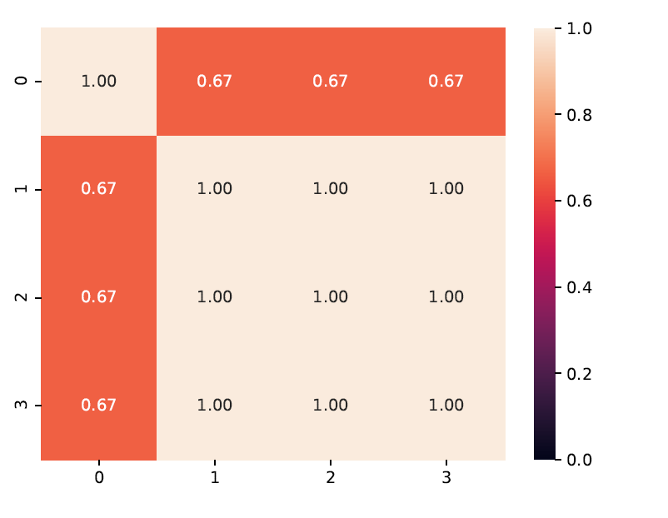
Full JSM (Jaccard Similarity Matrix) calculated linearly from Concept Lattice

Slide 37
JSM and Hierarchical Clustering
Cluster_{F,A}
CL0 | CL1
{0} | {1,2,3}
Definition Cluster_{F,A} :
Cluster_{F,A} = Hierarchical Clustering based on JSM_{F,A}
JSM_{F,A} = Jaccard Similarity Matrix extracted from CL_{F,A}
CL_{F,A} = Concept Lattice that we create from PTs when we apply Filter F to and extract Attribute A from traces
Concept lattice gives a set of clusters Clusters {c₁,c₂,...,c_{k}} where c_{i} is Cluster_{Fm,An}

Slide 38
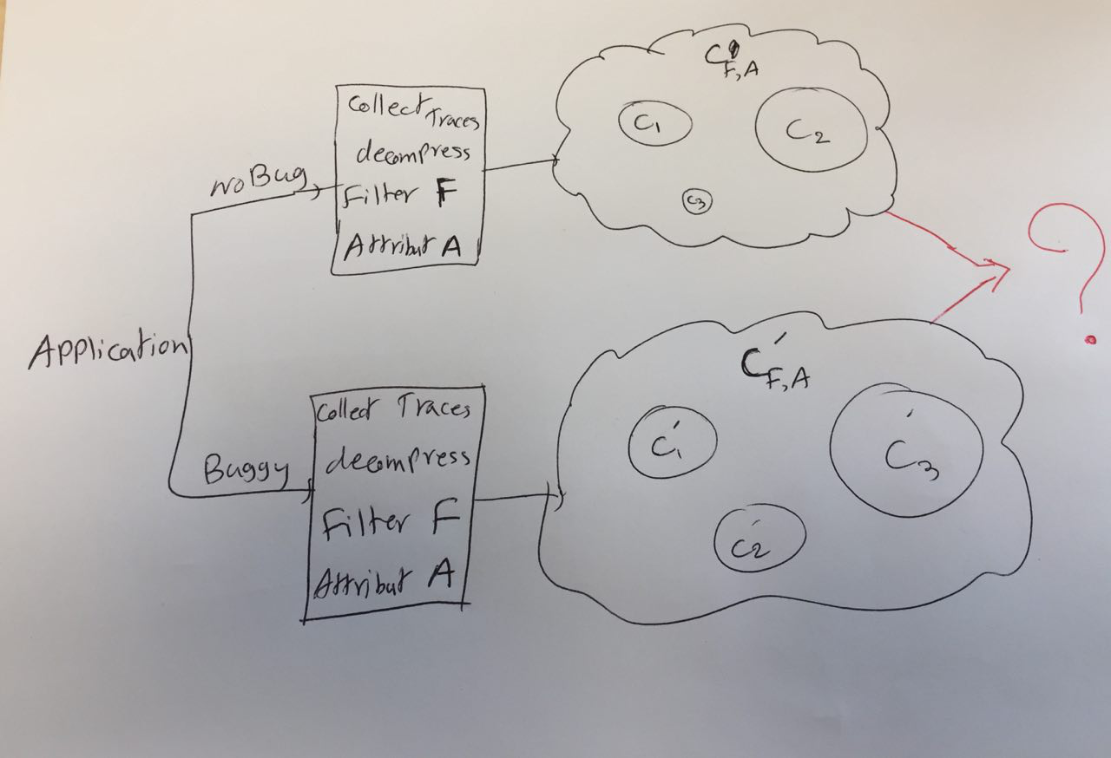
Now what?
Using FCA and its product JSM, we are able to reduce the search space to just a few clusters.
Now how can this help us towards debugging?

Slide 39
Now what?
Using FCA and its product JSM, we are able to reduce the search space to just a few clusters.
Now how can this help us towards debugging?
?: A Method to compare clusterings as a metric of difference

Slide 40
DiffTrace Components
After collecting ParLOT traces (main image or all images), here is the pipeline of trace processing and analysis in DiffTrace:
Preprocessing (implemented in C++):
Decompression
Filter (slide Filters)
NLR: Detecting Loops (inter-PT compression)
Forming Equivalent Classes of PTs (intra-PT compression) (implemented in C++)
Attribute Extraction
Concept Lattice Generation
Jaccard Similarity Matrix (JSM) Calculation
Analysis of JSMs and rank abnormal PTs for deeper analysis (implemented Python, SciPy, NumPy)
Tunable analysis
Iterative rankings
diffNLR (visualization of diffs of buggy PT vs. its corresponding native PT)

Slide 41
So Far in DiffTrace...
Intra-PT compression:
Decompress
Filter
Compress traces in form of NLR (Nested Loop Representation)
Inter-PT compression:
Extract attribute from each PT
Inject to Concept Lattice
Obtain full pair-wise Jaccard Similarity Matrix (JSM)
Resulting in few classes of equivalent PTs

Slide 42
So Far in DiffTrace...now Analysis
Intra-PT compression:
Decompress
Filter
Compress traces in form of NLR (Nested Loop Representation)
Inter-PT compression:
Extract attribute from each PT
Inject to Concept Lattice
Obtain full pair-wise Jaccard Similarity Matrix (JSM)
Resulting in few classes of equivalent PTs
Analysis:
Large parameter space
Diffing

Slide 43
Proposed Analysis Approach
Comparison of obtained clusterings:
Buggy vs. Bug-free
Mindset: How the bug changed the clusterings
Goal: Find the one (or the few) PT(s) that cause CL_{F,A} to become CL′_{F,A}
Those PT(s) are potential bug manifestation or bug root cause

Slide 44
Proposed Analysis Approach
Comparison of obtained clusterings:
Buggy vs. Bug-free
Mindset: How the bug changed the clusterings
Goal: Find the one (or the few) PT(s) that cause CL_{F,A} to become CL′_{F,A}
Those PT(s) are potential bug manifestation or bug root cause
Challenge: Large parameter space to search for abnormal PTs

Slide 45
A lot of Parameters
Filters |  |  |  |  |  |  |  |  |  | CL Attributes |  | Clustering
Prime |  | General |  | MPI |  | OMP |  | Other
Filter | Description | Filter | Description | Filter | Description | Filter | Description | Filter | Description
ret | Filter Returns | @plt | ...@plt | mpi | MPI_... | ompcrit | OMP critical | Custom | Defining specific regex to filter | set of <atr:freq> |  | single
 |  | mem | Memory related malloc memcpy etc | mpiall | ..MPI... MPID... PMPI... |  |  |  |  | Single: set of single trace entries atr: sing | No Frequency: only presence of attribute entries matters freq:- | complete
 |  | net | Network related |  |  | ompmutex | OMP mutex |  |  |  |  | average
.plt | Filter .plts | poll | Poll Related poll, yield | mpicol | MPI collectives |  |  |  |  |  | Log10: log(freq) of each entry matters (for large frequency numbers freq: log10(#atr) | weighted
 |  | str | String related stcpy strcmp etc |  |  |  |  | incEverything | Include whatever is not in the Filters | Double: set of 2-consecutive entries atr: doub |  | centroid
 |  |  |  | mpisr | MPI send/recv | ompall | OMP all functions |  |  |  | Actual: actual frequency of each entry matters freq: #atr | median
 |  |  |  |  |  |  |  |  |  |  |  | ward

Slide 46
Large Parameter Space Challenge
Each combination of parameters would result in:
Different set of NLR-PTs
Different set of Concept Lattices and JSMs
Thus: Reflecting different aspects of the execution

Slide 47
Large Parameter Space Challenge
Each combination of parameters would result in:
Different set of NLR-PTs
Different set of Concept Lattices and JSMs
Thus: Reflecting different aspects of the execution
In addition to the offline parameter space, ParLOT can collect broader traces (all images) or target only specific functions (pre-instrumentation filters)

Slide 48
Proposed Solution: Tunable/Iterative Post-Mortem Analysis of PTs
1. Start from basic/simple set of parameters
2. Calculate the JSM_{buggy} and JSM_{bug-free}
3. diffJSM = | JSM_{buggy} - JSM_{bug-free} |
4. Hierarchical Clustering of diffJSM
5. If there are outliers:
5.1. Check their diffNLR
5.2. If useful:
Success!
5.3. Else:
Go to 1 with different set of parameters
6. Else:
Go to 1 with different set of parameters

Slide 49
Hierarchy of Filters
Category | Sub-category | Description | Pros | Cons
Primary | Returns | Filter out Returns | - PT length reduction - Simpler to analyze | Losing call-stack information
 | PLT | Filter out PLT PLT stands for Procedure Linkage Table which is, put simply, used to call external procedures/functions whose address isn't known in the time of linking, and is left to be resolved by the dynamic linker at run time. | - PT length reduction - Simpler to analyze - PT become more structured | -
MPI | MPI ALL | Only keep functions that start with "MPI_" | Focus on MPI actions | -
 | MPI Collectives | Only keep MPI collectiv calls (MPI_Barrier, MPI_Allreduce, etc)
 | MPI Send/Recv | Only keep MPI_Send, MPI_Isend, MPI_Recv, MPI_Irecv and MPI_Wait
 | MPI Library | Keep all inner MPI library calls
OMP | OMP ALL | Only keep OMP calls (starting with GOMP_) | Focus on OMP actions | -
 | OMP Critical | Only keep OMP_CRITICAL_START and OMP_CRITICAL_END
 | OMP Mutex | Only keep OMP_Mutex calls
Secondary | Memory | Keep any memory related functions (memcpy, memchk, alloc, malloc, etc) | Focus on various aspects of the program behavior | -
 | Network | Keep any network related functions (network, tcp, sched, etc)
 | Poll | Keep any poll related functions (poll, yield, sched, etc)
 | String | Keep any string related functions (strlen, strcpy, etc)
Advanced | Custom | Any regular expression can be captured | Custom behavior checking | -
 | Everything | Does not filter anything | Not losing any information | - Redundant data - Increase the chance of false positives

Slide 50
Hierarchy of Filters
Category | Sub-category | Description | Pros | Cons
Primary | Returns | Filter out Returns | - PT length reduction - Simpler to analyze | Losing call-stack information
 | PLT | Filter out PLT PLT stands for Procedure Linkage Table which is, put simply, used to call external procedures/functions whose address isn't known in the time of linking, and is left to be resolved by the dynamic linker at run time. | - PT length reduction - Simpler to analyze - PT become more structured | -
MPI | MPI ALL | Only keep functions that start with "MPI_" | Focus on MPI actions | -
 | MPI Collectives | Only keep MPI collectiv calls (MPI_Barrier, MPI_Allreduce, etc)
 | MPI Send/Recv | Only keep MPI_Send, MPI_Isend, MPI_Recv, MPI_Irecv and MPI_Wait
 | MPI Library | Keep all inner MPI library calls
OMP | OMP ALL | Only keep OMP calls (starting with GOMP_) | Focus on OMP actions | -
 | OMP Critical | Only keep OMP_CRITICAL_START and OMP_CRITICAL_END
 | OMP Mutex | Only keep OMP_Mutex calls
Secondary | Memory | Keep any memory related functions (memcpy, memchk, alloc, malloc, etc) | Focus on various aspects of the program behavior | -
 | Network | Keep any network related functions (network, tcp, sched, etc)
 | Poll | Keep any poll related functions (poll, yield, sched, etc)
 | String | Keep any string related functions (strlen, strcpy, etc)
Advanced | Custom | Any regular expression can be captured | Custom behavior checking | -
 | Everything | Does not filter anything | Not losing any information | - Redundant data - Increase the chance of false positives
Any of these filters can be enabled or disabled at the same time using a bitset

Slide 51
Example
Run and collect ParLOT traces from execution of ILCS-TSP with 8 processes and 5 threads on each (40 total PT)
$> mpirun -np 8 pin -t parlotm.so -- ./ILCS-TSP

Slide 52
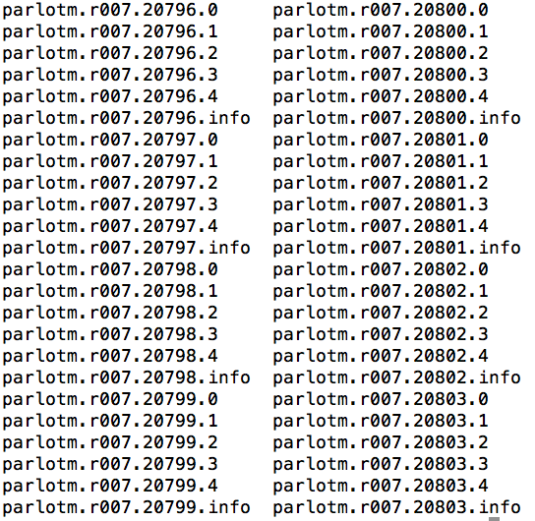
Example
Run and collect ParLOT traces from execution of ILCS-TSP with 8 processes and 5 threads on each (40 total PT)
$> mpirun -np 8 pin -t parlotm.so -- ./ILCS-TSP

Slide 53
Example
Run and collect ParLOT traces from execution of ILCS-TSP with 8 processes and 5 threads on each (40 total PT)
$> mpirun -np 8 pin -t parlotm.so -- ./ILCS-TSP
Pre-Processing with:
Decompress
Filter: MPI All
Attribute: Double:Actual
Create CL and JSM

Slide 54
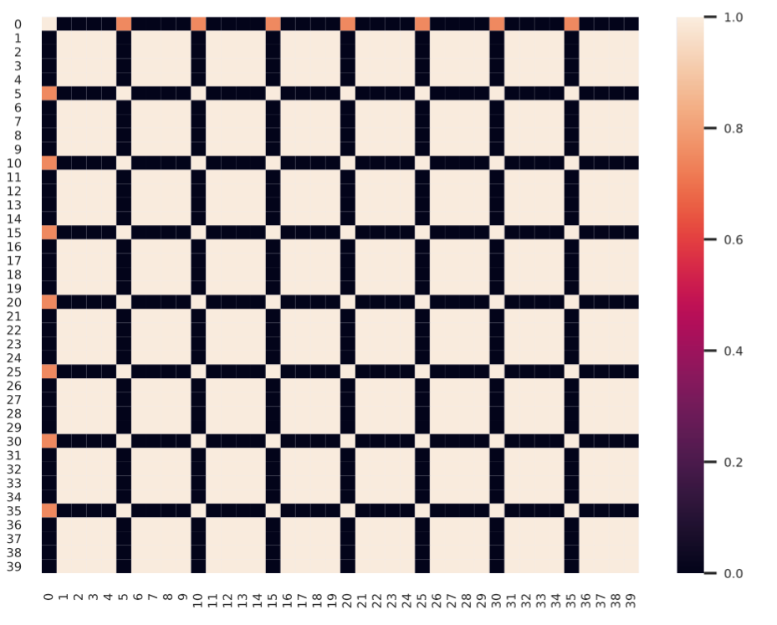
Example
Run and collect ParLOT traces from execution of ILCS-TSP with 8 processes and 5 threads on each (40 total PT)
$> mpirun -np 8 pin -t parlotm.so -- ./ILCS-TSP
Pre-Processing with:
Decompress
Filter: MPI
Attribute: Double:Actual
Create CL and JSM

Slide 55
Example
Now we inject a BUG! Bug description: Different operation (MPI MAX) instead of (MPI MIN) in MPI_Allreduce() (only one process)
Runtime: No error, deadlock, crash or exception. Potential wrong answer !
Run and collect ParLOT traces from execution of ILCS-TSP with 8 processes and 5 threads on each (40 total PT)
$> mpirun -np 8 pin -t parlotm.so -- ./ILCS-TSP
Pre-Processing with:
Decompress
Filter: MPI
Attribute: Double:Actual
Create CL and JSM

Slide 56
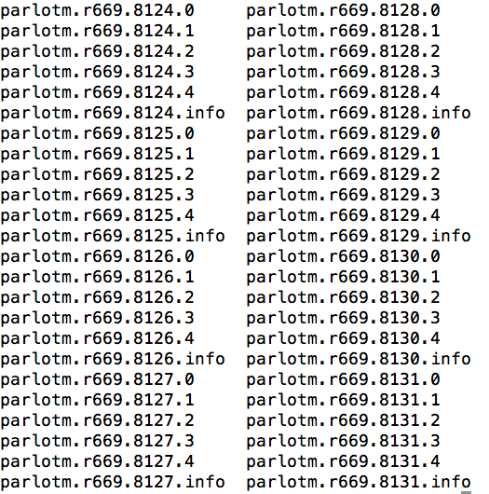
Example (bug injected)
$> mpirun -np 8 pin -t parlotm.so -- ./ILCS-TSP-buggy

Slide 57
Example (bug injected)
$> mpirun -np 8 pin -t parlotm.so -- ./ILCS-TSP-buggy
Pre-Processing with:
Decompress
Filter: MPI All
Attribute: Double:Actual
Create CL and JSM

Slide 58
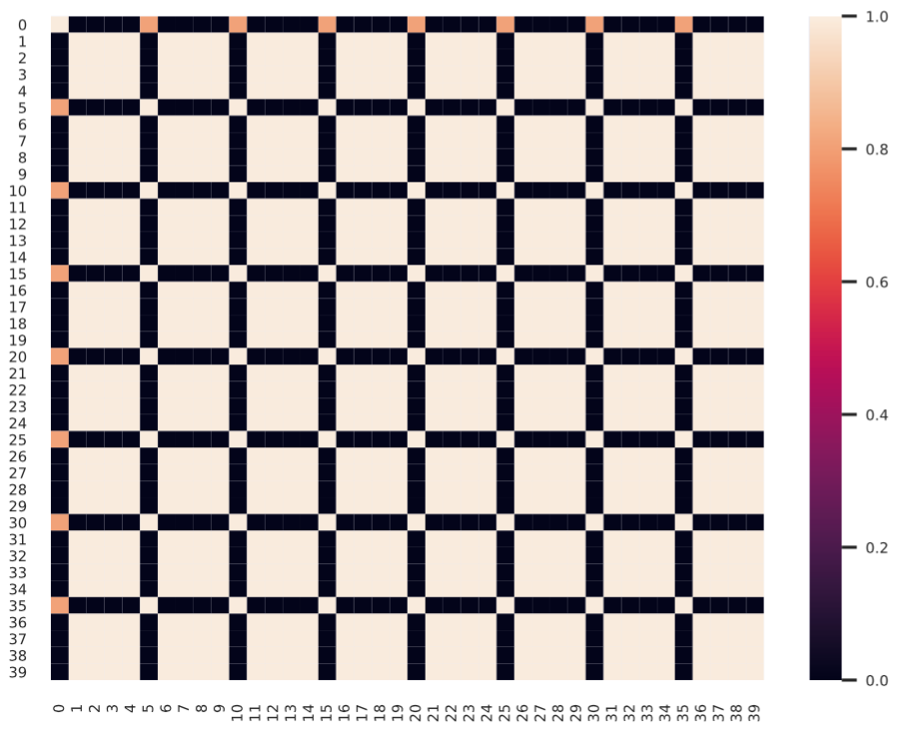
Example (bug injected)
$> mpirun -np 8 pin -t parlotm.so -- ./ILCS-TSP-buggy
Pre-Processing with:
Decompress
Filter: MPI
Attribute: Double:Actual
Create CL and JSM

Slide 59
Let’s compare JSMs
JSM_{buggy}

Slide 60
Let’s compare JSMs
JSM_{buggy}
JSM_{bug-free}

Slide 61
Let’s compare JSMs
JSM_{buggy}
JSM_{bug-free}

Slide 62
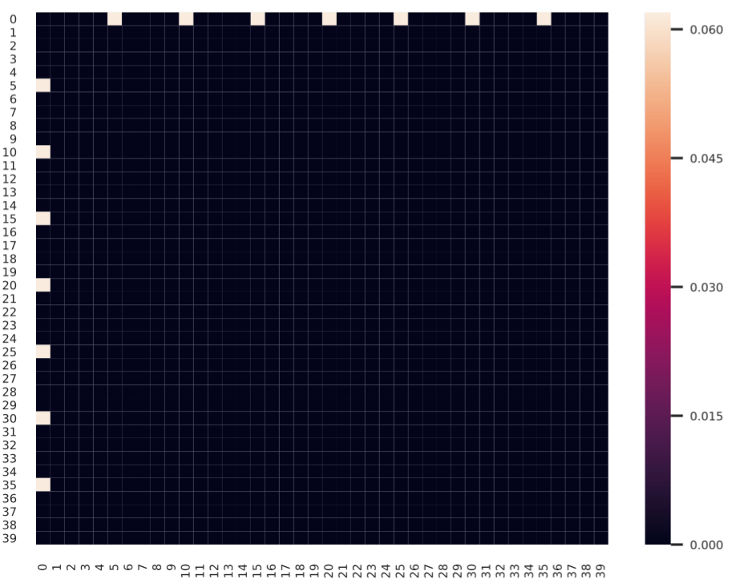
Let’s compare JSMs
JSM_{buggy}
JSM_{bug-free}

Slide 63
Let’s compare JSMs
JSM_{buggy}
JSM_{bug-free}
Hierarchical clustering based on diffJSM: - Cluster 1 : 39 PTs
- Cluster 2: 1 PT (PT_{0,0})

Slide 64
Now lets see what has changed in PT_{0,0} after we inject the bug...

Slide 65
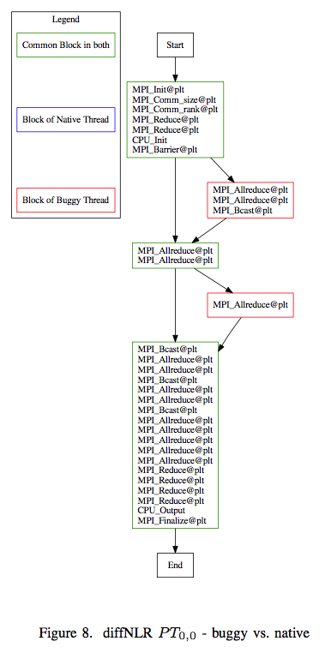
Now lets see what has changed in PT_{0,0} after we inject the bug...

Slide 66
Observation:
The target MPI_Allreduce() that we injected the bug to, finds the rank (i.e., process) that has the “champion” result among all of ranks using MPI_MIN operator. Then that champion rank copies its “champion results” to a global data-structure and broadcast the “champion results” to all other ranks for the next time step.
However, since we changed the MPI_MIN to MPI_MAX in only one of the ranks, the true champion rank would get lost, instead a false champion rank (which turned to be rank 0 (PT_{0,0})) would broadcast its results as champion in the first time-step, causing a potential wrong answer.

Slide 67
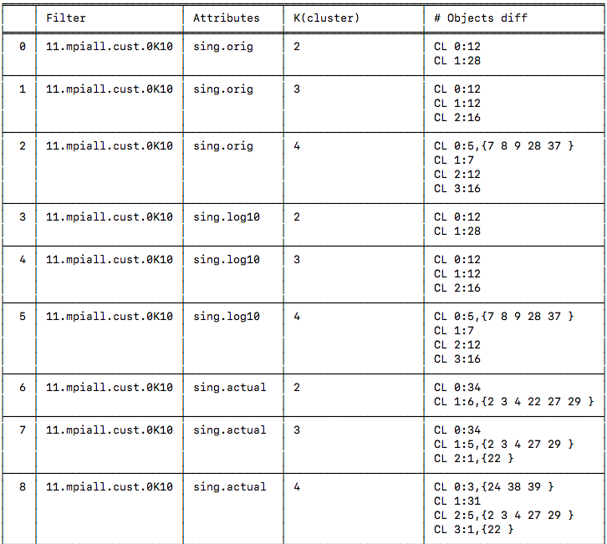
This is how the Recommendation Table look like

Slide 68
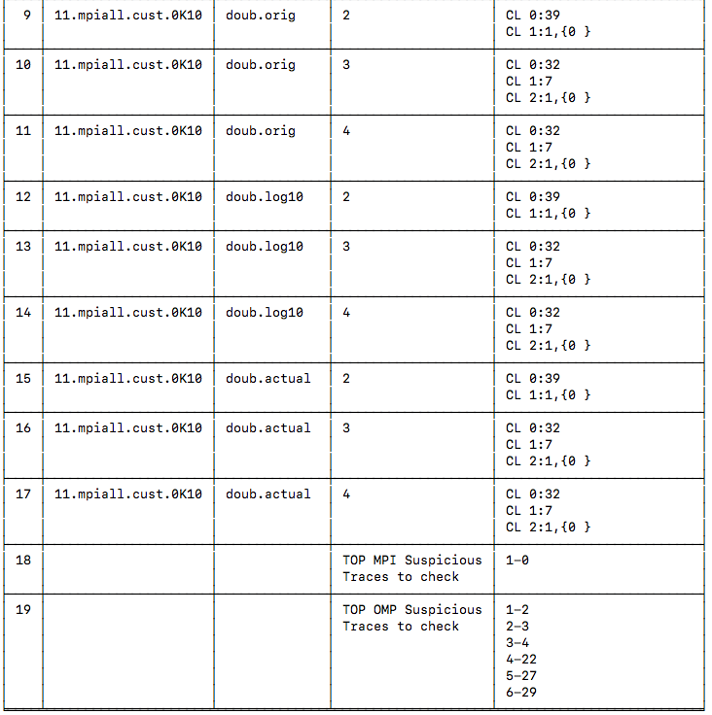
This is how the Recommendation Table look like

Slide 69
This is how the Recommendation Table look like

Slide 70
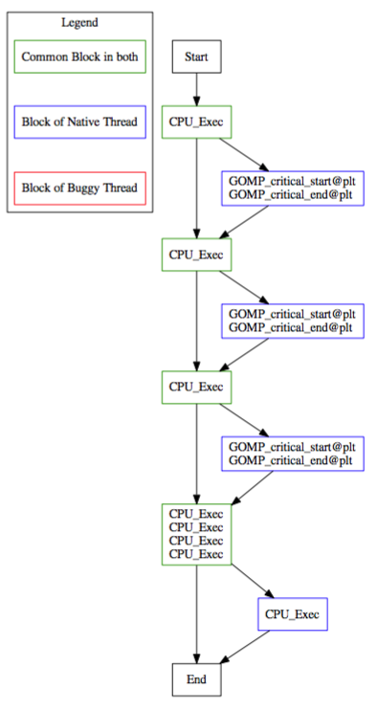
Another Example
Similar to the previous example, after a few iterations over the parameter space, I could also catch an OMP level bug that I injected.
I modified the source-code of ILCS-TSP so that only thread 2 of process 3 access a shared memory location without protecting the mutual exclusion (by skipping critical section pragma).
JSM comparison of buggy vs. bug-free with OMP-related filters, put a single PT (PT_{3,2}) in a single cluster.
diffNLR of PT_{3,2} of buggy version vs. its corresponding bug-free PT, shows clearly the the buggy PT is skipping the critical section for memory accesses (memcpy).

Slide 71
Is this approach convincing for reviewers?
I have injected other bugs that cause crash or deadlocks and can be explained with similar approach.

Slide 72
Is this approach convincing for reviewers?
I have injected other bugs that cause crash or deadlocks and can be explained with similar approach.
I was trying to build a confusion matrix (List of True Positives, False Positives, etc.), but it does not make sense in our tunable iterative approach

Slide 73
Is this approach convincing for reviewers?
I have injected other bugs that cause crash or deadlocks and can be explained with similar approach.
I was trying to build a confusion matrix (List of True Positives, False Positives, etc.), but it does not make sense in our tunable iterative approach
ILCS only has a few MPI collectives.

Slide 74
Is this approach convincing for reviewers?
I have injected other bugs that cause crash or deadlocks and can be explained with similar approach.
I was trying to build a confusion matrix (List of True Positives, False Positives, etc.), but it does not make sense in our tunable iterative approach
ILCS only has a few MPI collectives.
So our hands are not that wide open to exhibit convincing stories

Slide 75
Is this approach convincing for reviewers?
I have injected other bugs that cause crash or deadlocks and can be explained with similar approach.
I was trying to build a confusion matrix (List of True Positives, False Positives, etc.), but it does not make sense in our tunable iterative approach
ILCS only has a few MPI collectives.
So our hands are not that wide open to exhibit convincing stories
PIC code has a lot of non-blocking sends and receives, thus more interesting bugs can be injected and the final results would be more convincing

Slide 76
Is this approach convincing for reviewers?
I have injected other bugs that cause crash or deadlocks and can be explained with similar approach.
I was trying to build a confusion matrix (List of True Positives, False Positives, etc.), but it does not make sense in our tunable iterative approach
ILCS only has a few MPI collectives.
So our hands are not that wide open to exhibit convincing stories
PIC code has a lot of non-blocking sends and receives, thus more interesting bugs can be injected and the final results would be more convincing
Your thoughts and feedback would be so much valuable for me.
Thanks

Slide 77
Plan
Run more experiments with ILCS with variations that Martin suggested:
Single task off
OMP bugs: All threads, one thread, every other thread
Every other process off
OMP bugs: All threads, one thread, every other thread
All except one off
OMP bugs: All threads, one thread, every other thread
Bugs:
MPI: Allreduce wrong size
MPI: Allreduce wrong op
OMP: Critical section
Goal: Pinpointing where the bug is manifesting and/or root causes of the failure
Approach: Generating ranking tables with targeted filters

